Slide 1
HADOOP ECOSYSTEM

Slide 2
CONTENTS
What Is Hadoop
Hadoop Architecture
Hadoop Services
Hadoop Ecosystem
Hdfs, Hive,Hbase,Mapreduce,Pig,Sqoop,Flume,Zookeeper,
Advantage of Hadoop
Disadvantage of Hadoop
Use of Hadoop
References
Conclusion

Slide 3
WHAT IS HADOOP
Hadoop is the product of Apach ,it is the type of distributed system, it is framework for big data
Apache Hadoop is an open-source software framework for storage and large-scale processing of data-sets on clusters of commodity hardware.
Some of the characteristics:
Open source
Distributed processing
Distributed storage
Reliable
Economical
Flexible

Slide 4
Hadoop Framework Modules
The base Apache Hadoop framework is composed of the following modules:
Hadoop Common :– contains libraries and utilities needed by other Hadoop modules
Hadoop Distributed File System (HDFS) :– a distributed file-system that stores data on commodity machines, providing very high aggregate bandwidth across the cluster
Hadoop YARN:– a resource-management platform responsible for managing computing resources in clusters and using them for scheduling of users' applications
Hadoop MapReduce:– an implementation of the MapReduce programming model for large scale data processing.

Slide 5
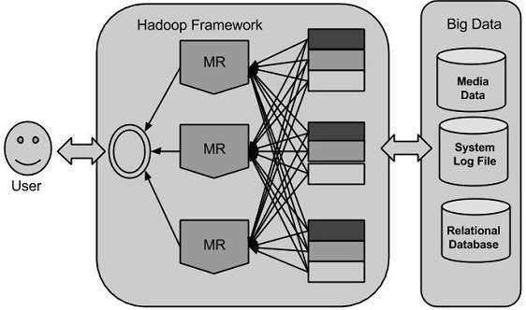
Framework Architecture

Slide 6
Hadoop Services
Data Storage
1. HDFS (Hadoop distributed file System)
a)Horizontally Unlimited Scalability
(No Limit For Max no.of Slaves)
b)Block Size=64MB(old Version)
128MB(New Version)
Data Process
MapReduce(Old Model)
Spark(New Model)

Slide 7
Hadoop Architecture
Hadoop consists of the Hadoop Common package, which provides file system and OS level abstractions, a MapReduce engine and the Hadoop Distributed File System (HDFS).
The Hadoop Common package contains the necessary Java Archive (JAR) files and scripts needed to start Hadoop.

Slide 8
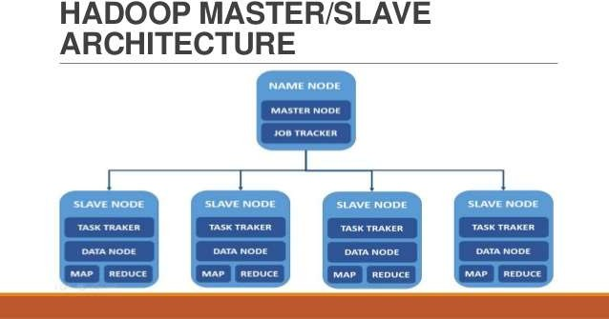

Slide 9
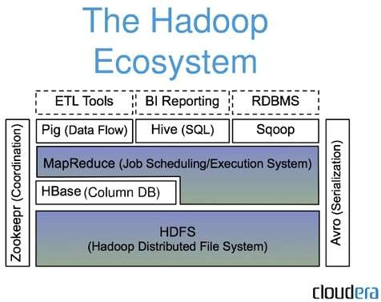

Slide 10
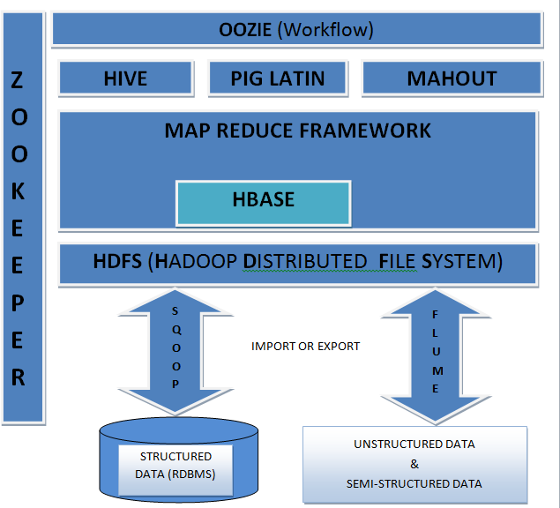
Working Of Ecosystem

Slide 11
HDFS
Hadoop Distributed File System (HDFS) is designed to reliably store very large files across machines in a large cluster. It is inspired by the GoogleFileSystem.
Distribute large data file into blocks which are then copied to multiple Data Nodes.
Blocks are managed by different nodes in the cluster.
Hadoop cluster contains only one NameNode and many DataNodes.
Each block is replicated on multiple nodes.Data blocks are replicated for High Availability and fast access.
Name node stored metadata information about files and blocks

Slide 12
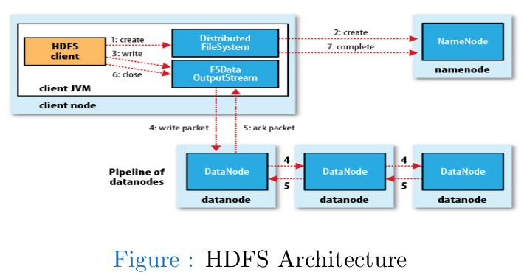
NameNode
Run on a separate machine.
Manage the file system namespace,and control access of external clients.
Store file system Meta-data in memory.
File information, each block information of files, and every file block information in Data Node .
DataNode
1)Run on Separate machine,which is the basic unit of file storage.
2)Sent all messages of existing Blocks periodically to Name Node.
3)Data Node response read and write request from the Name Node,and also respond, create, delete, and copy the block command from Name Node.

Slide 13
MAPREDUCE
The Mapper:-
Each block is processed in isolation by a map task called mapper
Map task runs on the node where the block is stored
Map process each block separately in parallel.
Generate an intermediate key/value pairs set.
Results of these logic blocks are reassembled.
The Reducer:-
Consolidate result from different mappers
Accepts an intermediate key and related value.
Processed the intermediate key and value.
Produce final output.

Slide 14
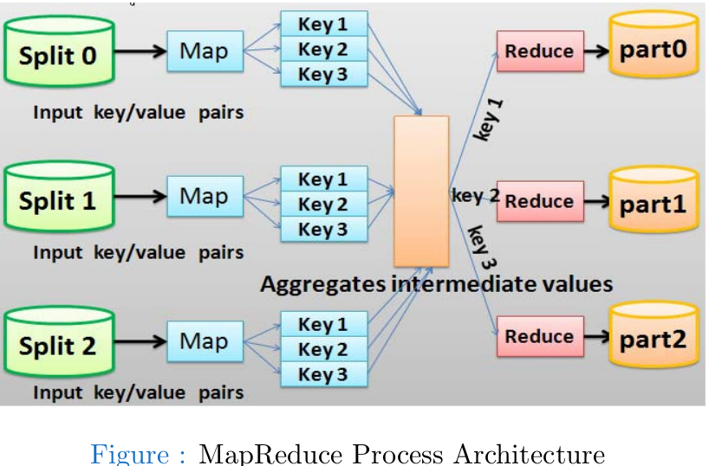

Slide 15
HBASE
HBase is distributed column-oriented database built on top of HDFS.
HBase is not relational and does not support SQL, but given the proper problem space.
It is able to do what an RDBMS cannot.
HBase is modeled with an HBase master node orchestrating a cluster of one or more regionserver slaves.
HBase master is responsible for bootstrapping a virgin install, for assigning regions to registered regionservers, and for recovering regionserver failures.
HBase manages a ZooKeeper instance as the authority on cluster state.

Slide 16
HBASE
Hadoop database for random read/write access
Features of HBASE:-
Type of NoSql database
Strongly consistent read and write
Automatic sharding
Automatic RegionServer failover
Hadoop/HDFS Integration
HBase supports massively parallelized processing via MapReduce for using HBase as both source and sink.
HBase supports an easy to use Java API for programmatic access.
HBase also supports Thrift and REST for non-Java front-ends.

Slide 17
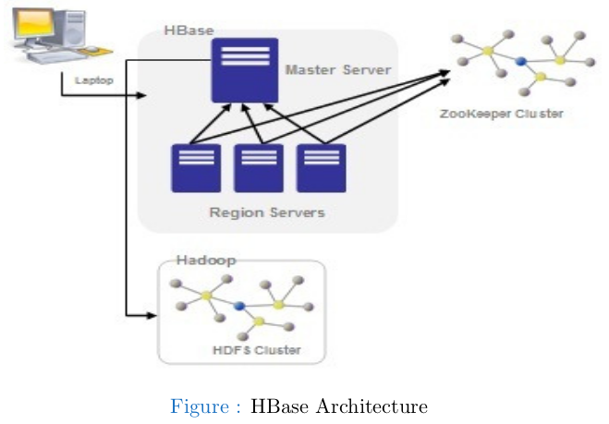

Slide 18
HIVE
SQL-like queries and tables on large datasets
Features of HIVE:-
An sql like interface to Hadoop.
Data warehouse infrastructure built on top of Hadoop
Provide data summarization, query and analysis
Query execution via MapReduce
Hive interpreter convert the query to Map reduce format.
Open source project.
Developed by Facebook
Also used by Netflix, Cnet, Digg, eHarmony etc.

Slide 19
PIG
Data flow language and compiler
Features of pig:-
A scripting platform for processing and analyzing large data sets
Apache Pig allows to write complex MapReduce programs using a simple scripting language.
High level language: Pig Latin
Pig Latin is data flow language.
Pig translate Pig Latin script into MapReduce to execute within Hadoop.
Open source project
Developed by Yahoo

Slide 20
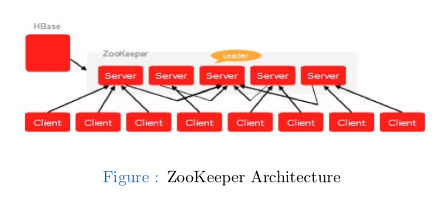
ZOOKEEPER
Coordination service for distributed applications
Features of Zookeeper:-
Because coordinating distributed systems is a Zoo.
ZooKeeper is a centralized service for maintaining configuration information, naming, providing distributed synchronization, and providing group services.

Slide 21
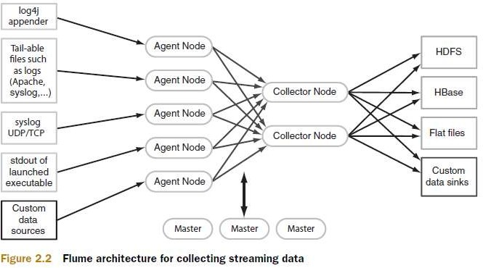
FLUME
Configurable streaming data collection
Apache Flume is a distributed, reliable, and available service for efficiently collecting, aggregating, and moving large amounts of streaming data into the Hadoop Distributed File System (HDFS).

Slide 22
SQOOP
Integration of databases and data warehouses with Hadoop
Features of Sqoop:-
Command-line interface for transforming data between relational database and Hadoop
Support incremental imports
Imports use to populate tables in Hadoop
Exports use to put data from Hadoop into relational database such as SQL server
Hadoop
Sqoop
RDBMS

Slide 23
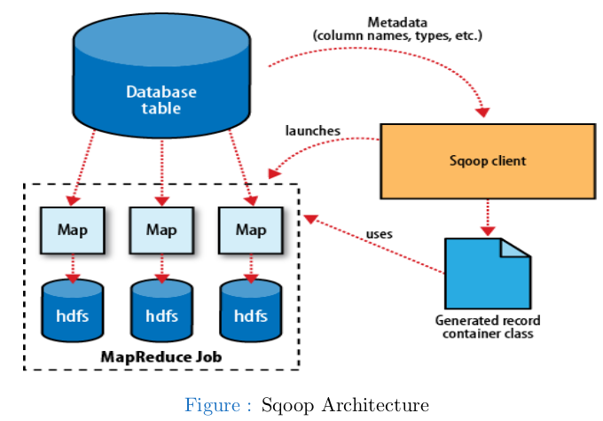

Slide 24
OOZIE
To design and schedule workflows
Oozie is a workflow scheduler where the workflows are expressed as Directed Acyclic Graphs.
Oozie runs in a Java servlet container Tomcat and makes use of a database to store all the running workflow instances, their states ad variables along with the workflow definitions to manage Hadoop jobs (MapReduce, Sqoop, Pig and Hive).
The workflows in Oozie are executed based on data and time dependencies.

Slide 25
Hadoop Advantages
Unlimited data storage
Server Scaling Mode
Vertical Scale
b)Horizontal Scale
High speed processing system
All varities of data processing
Structural
Unstructural
semi-structural

Slide 26
Disadvantage of Hadoop
If volume is small then speed of hadoop is bad
Limitation of hadoop data storage
Well there is obviously a practical limit. But physically HDFS Block IDs are Java longs so they have a max of 2^63 and if your block size is 64 MB then the maximum size is 512 yottabytes.
Hadoop should be used for only batch processing
Batch process:-background process
where user can’t interactive
Hadoop is not used for OLTP
– OLTP process:-interactive with uses

